Slide 1
Going, Going, … Gone Green
Natural Burial Practices
Can we do Good when we’re Dead?
December 2022
Notes:
Introduce ourselves: Terry, then Katie
Katie:
We are here to talk about the issues with our current burial practices, and then about Natural Burial Practices.
Terry:
The answer to the question in our subtitle is a resounding YES, we CAN do good when we’re dead.
That’s what I like about this subject: it’s something you can DO something about. So much of what’s environmentally wrong with our practices in life we can’t do anything about as individuals. So, feel empowered!

Slide 2

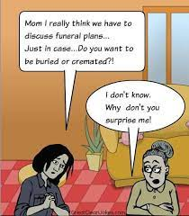
The key is to talk about your choices with your loved ones
Notes:
Katie:
Pause for audience to read slide
This is a subject that is often difficult to talk about, so we will tell you about various practices. We want you to you get familiar with the language so you can have this conversation with your loved ones or those who might have to take care of your final arrangements when you pass.

Slide 3
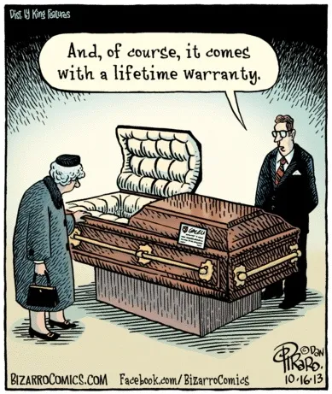
It’s time to think outside the box!
Notes:
Terry
Pause for reading slide
Even if you’re already committed to a family plot, there are choices you can make, as long as you’re alive.

Slide 4
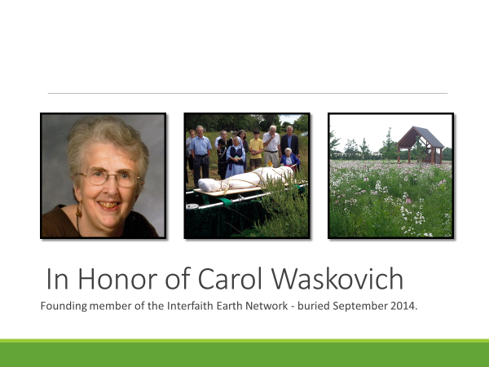
Notes:
Katie:
The first thing that we should say is that we are NOT experts in this topic.
We first became interested in the topic because Carol Waskovich, a founding member of the Interfaith Earth Network, of which both Terry and I were members, died and was buried in September 2014.
She had a Green Burial at Prairie Home Cemetery in Waukesha. She did a lot of good when she was dead – as well as when she was alive – as she inspired us to carry on with spreading the message about natural burial.
The picture on the right is of the natural burial area of Prairie Home Cemetery.

Slide 5
How else we became interested in this topic
  Live green, die green (sustainable legacy)
  Program “Why Green Burial? World Faith Practices and Sustainable Options” and tabling for Interfaith Earth Network
Notes:
Katie:
[talk from slides]: Many who are trying to live their lives in a “greener” more sustainable way are now exploring options for leaving a more sustainable legacy through their burial choices.
Carol’s natural burial prompted us to learn more about these options and begin to share them with others, i.e., programs and tabling events.

Slide 6
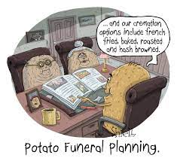
Cremation Options
French fried,
baked,
roasted,
and hash browned.
Notes:
Terry:
Pause for reading slide
But, we’re not potatoes, and the issue of how to treat human remains is a sensitive one; with as many traditions as there are cultures, and we have great respect for all those who go through this process. Conversations around this topic often lead to two conclusions about what to do with the deceased: either traditional cemetery burial or cremation.
However, there are several alternatives that have been emerging over the past couple of years.

Slide 7

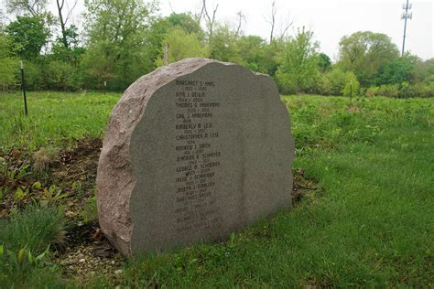



Definition of green or natural burial
The burial of a body
  Without embalming
  In a container, shroud, or no container at all
  Directly into the ground without the use of a concrete vault or liner
The emphasis of a green burial is to care for the dead with minimal impact to the environment
  Conservation of natural resources
  Reduction of carbon emissions
  Protection of worker health
  Restoration and/or preservation of habitat
Notes:
Katie:
We will be using the terms green or natural burial interchangeably in this presentation. Before we get much deeper into our presentation, we should define what we mean. [Talk from slide.](next) x9
Terry:
By the way, this picture is from the Prairie Rest section of Forest Home Cemetery, their natural burial area. The names of those buried there are inscribed on the rock, if they wish. As of the summer, when I attended the funeral of Bill Sell, whom I’m guessing some of you knew, I think there were two stones, both quite full of names.

Slide 8
What’s the matter with current burial practices?
Embalming
Caskets & Concrete Burial Vaults
Land Use
Maintenance of Cemeteries
Cremation
Notes:
Katie:
What’s the matter with current burial practices, and why do we need alternatives?
[Talk from Slide] We’ll go into each of these in detail.

Slide 9
Issues with Embalming
Chemicals like formaldehyde to preserve bodies
  dates to ancient Egypt
  Caught on in the U.S. during the Civil War, to transport fallen soldiers home
1 million people are embalmed in U.S. every year
  3 to 4 gallons of chemicals for average body
Toxic to people who do the embalming
Although: Organic embalming is available now with formaldehyde-free plant extracts
Notes:
Terry:
There are at least three issues with embalming. (Next) First the blood is drained out. The issue is that the body is then filled with chemicals like formaldehyde, a carcinogen, to preserve bodies. The practice dates to ancient Egypt, though of course they didn’t use modern toxic chemicals. In the U.S., the practice caught on during the Civil War, to transport soldiers home from the battlefield. We should note that embalming does NOT prevent the body from decomposing.
Katie –tell the joke about Beethoven --
(Next) Second, one million people are embalmed in U.S. every year, and 3 to 4 gallons of chemicals are used to preserve the average body. 1 million times 3 to 4 – yikes! That’s 5 or 6 Olympic-sized swimming pools-full – in just the U.S.!
And – embalming fluid can and does leak into soil and thus groundwater, potentially at hazardous concentrations.
(Next) The formaldehyde doesn’t bother the dead body, but it’s toxic to the people who do the embalming – putting them at an 8x higher risk for leukemia and a 3x higher risk for ALS, Lou Gehrig’s Disease, compared to the general population. I sure don’t want to be poisoning people so I can look good in a casket for a few hours!
(Next) We understand that organic embalming, without the toxic chemicals, is available now – but we don’t know how widely it’s available.
Further note – embalming is NOT a legal requirement.

Slide 10
Issues with Caskets
Figures from “We Need a Greener Way to Die” article in Popular Science
  Tons of wood, steel, copper, and bronze for caskets
  Buried in concrete or steel vault – both are large GHG emitters
  No return of bodily nutrients, like potassium and calcium, to the ground
  Lack of oxygen causes wasting flesh to release methane
  Embalming fluid can leak into soil
Notes:
Katie:
The use of caskets and vaults pose their own sets of problems. An article in Popular Science details the board feet, and tons of the resources: (talk from slides: (Next) (Next) (Next) (Next) (Next)
- the sourcing, processing, manufacturing and transport of those materials uses a lot of energy as well
- purchase of standard funeral goods also can do economic, cultural and health damage to the countries and the people where they are harvested
Further, concrete containers/vaults/grave liners:
- do not “protect” the body from animals, insects, grave robbers, & the elements
- do not allow for the return of bodily nutrients, like potassium & calcium to the ground
- rather, a lack of oxygen in the decomposing body causes a release of methane.

Slide 11
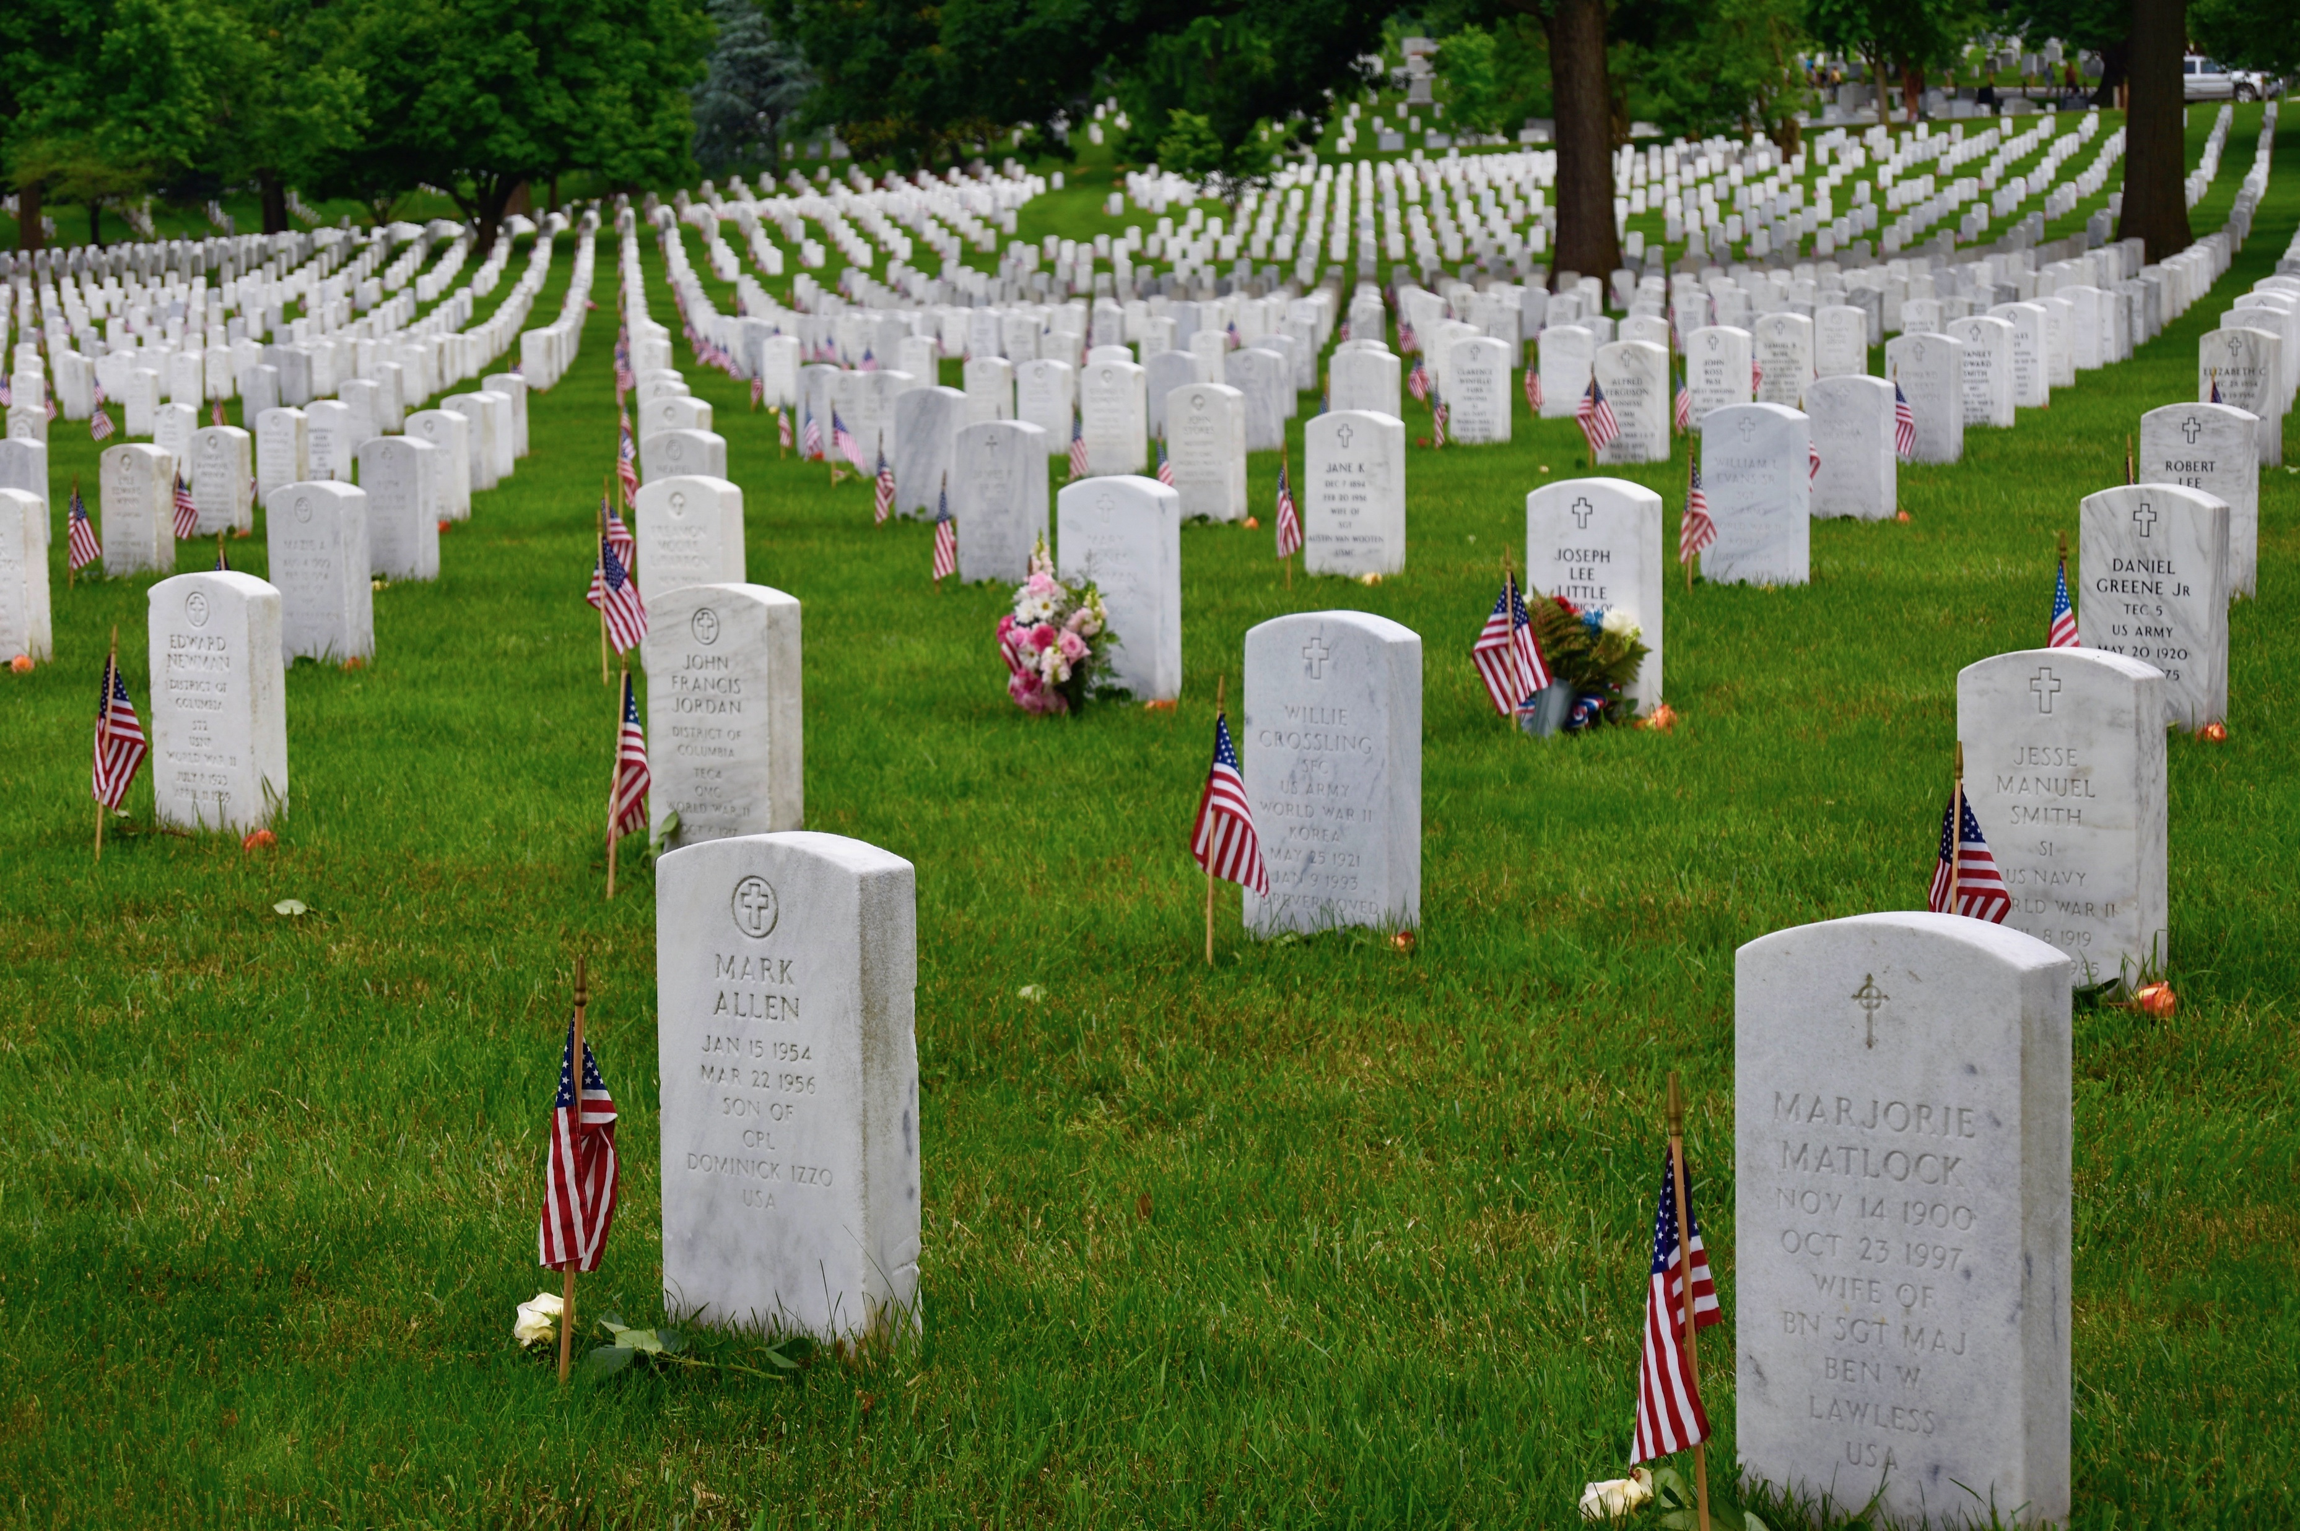
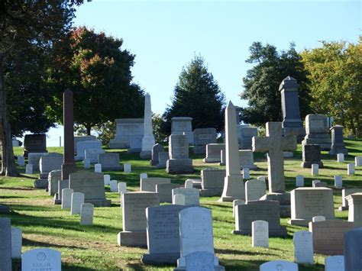
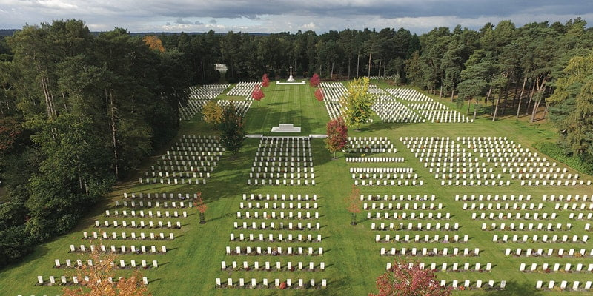
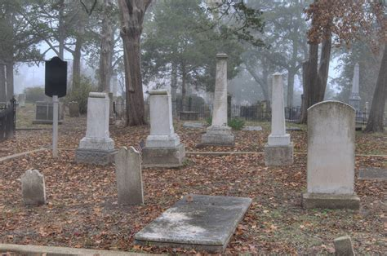
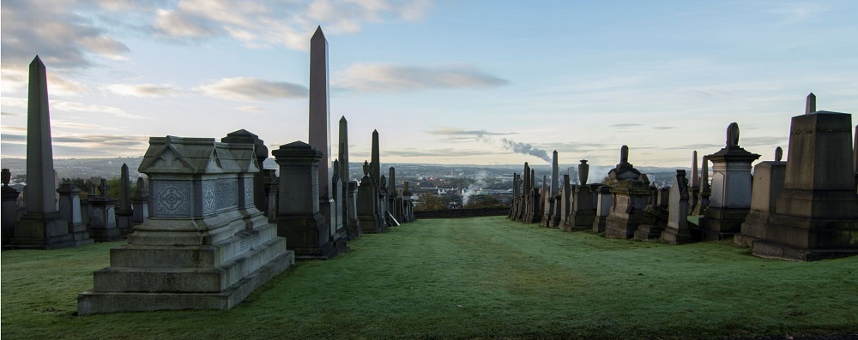
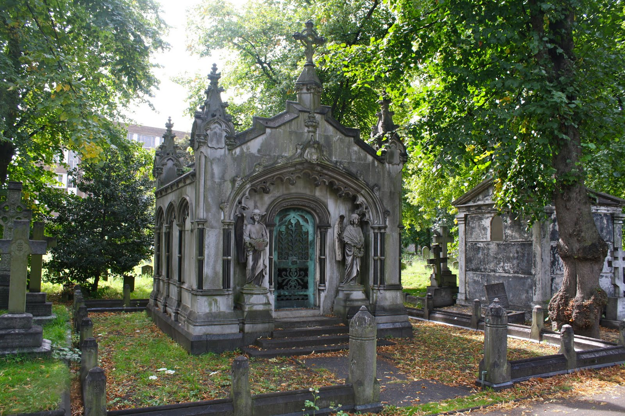
Issues of Land use
Notes:
Terry:
So many cemeteries, all over the country and the world using up so much land in perpetuity. This was my original motivation for choosing cremation, which was my choice before I learned about natural burial options.
And cities are running out of space for cemeteries.
And, of course, all those grave markers use resources, too. Trevor Noah, host of the Daily Show, has a segment on green burials, and he opens it with supply chain issues and the shortage of headstone materials during the worst of the pandemic.

Slide 12
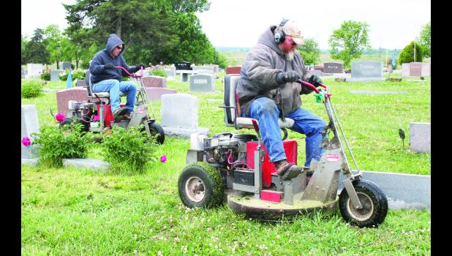
Issues with Cemetery
Maintenance
Notes:
Terry:
No state requires burial inside a vault. These regulations come from the cemeteries themselves, for the purpose of preventing the soil from settling so it is easier to mow. Small engines, like you see in the picture, are large Green House Gas emitters.
In addition, the cemeteries put various pesticides on lawns, to keep out the weeds, and to make them grow, so they can be cut down with the small engines.
And of course, those keep the pollinators, that is, the bees and butterflies, from living on that area of sterile land.
The sacred space has become a toxic landfill.

Slide 13
Cremation has pros and cons
+ : May be lighter on chemicals
+ : Uses up less space
~ : May not require watering and mowing
BUT:
- : Takes around 28 gallons of fuel per body
- : Very high carbon footprint
- : High toxic emissions
- : Crematories often operate in front-line or environmental justice communities
Notes:
Katie:
Let’s talk about flame cremation. Since 2015, cremation using fire has been the most popular death care practice in the US. Amid the pandemic, local air quality regulators repeatedly lifted cremation limits to allow for coping with the “backlog” of dead. In many countries, cremation has become the death care option of choice for most people.
Many believe erroneously that cremation is more environmentally friendly than conventional burial. But as cremation becomes more commonplace, concerns about its effects on the environment and climate have been mounting.
(Next) It may be lighter on chemicals. (Body might still be embalmed for viewing first.)
(Next) It generally uses up less space for storage of the body.
(Next) It may not require watering and mowing, depending on where the ashes are stored – sometimes they’re buried in a cemetery.
Terry:
BUT -- and these are big buts—
(Next) It requires around 3 hours of burning at very high temperatures using about 28 gallons of fuel per body. (next) It has a very high carbon footprint, (600 lbs of CO2 per body).
(Next) And there are high toxic emissions from the burning process and from what was in the body. Cremation is the third highest emitter of mercury into the atmosphere.
(Next) Crematories often operate in front-line or environmental injustice communities.

Slide 14
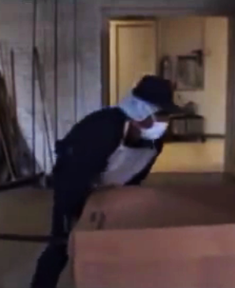
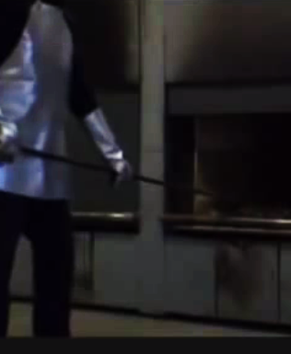
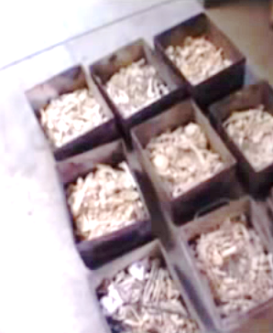
Cremation
Notes:
Terry:
And here are some pictures of the process and its results.

Slide 15
FTC Funeral Rule: https://www.consumer.ftc.gov/articles/0300-ftc-funeral-rule
Your Rights Under the Funeral Rule
Buy only the funeral arrangements you want.
Get price information on the telephone.
Get a written, itemized price list when you visit a funeral home.
See a written casket price list before you see the actual caskets.
See a written outer burial container price list. (outer containers are not required by law anywhere in the U.S.]
Receive a written statement after you decide what you want, and before you pay.
Get an explanation in the written statement from the funeral home that describes any legal cemetery or crematory requirement that requires you to buy any funeral goods or services.
Use an “alternative container” instead of a casket for cremation.
Make funeral arrangements without embalming.
Notes:
Katie:
If you’ve lived your whole life trying to reduce your carbon footprint, knowing what is and isn’t legal or required is important. There can be state & local regulations, cemetery regulations, and simply cultural or local “traditions.” Myths and assumptions about death care abound.
The Federal Trade Commission’s Funeral Rule rule makes it possible for you to choose only those goods and services you want or need and to pay only for those you select, whether you are making arrangements when a death occurs or in advance.
The Rule allows you to compare prices among funeral homes and makes it possible for you to select the funeral arrangements you want at the home you use.
The Rule does not apply to third-party sellers, such as casket and monument dealers, or to cemeteries that lack an on-site funeral home.
Consider this: purchase of standard funeral goods has often been highly motivated by the sentiment that the more we spend, the more we demonstrate our love for the deceased. More people are rejecting this maxim and choosing to purchase items that reflect their basic values in living & dying sustainably.

Slide 16
What are the alternatives?
(In some states)
“Green” or “Natural” Burial
  Green Burial Council Certifies types of Cemeteries
Alternatives for cremated remains:
  Can be turned into trees or diamonds
  Can be incorporated into reef balls (I’ll show a picture)
Alkaline Hydrolysis, a.k.a. water cremation, aquamation, bio cremation, or resomation
Natural Organic Reduction, a.k.a. human composting
Infinity Burial Suit, a.k.a. mushroom suit
Notes:
Terry
[read slide] (next) x 7
We’ll talk about most of the alternatives

Slide 17
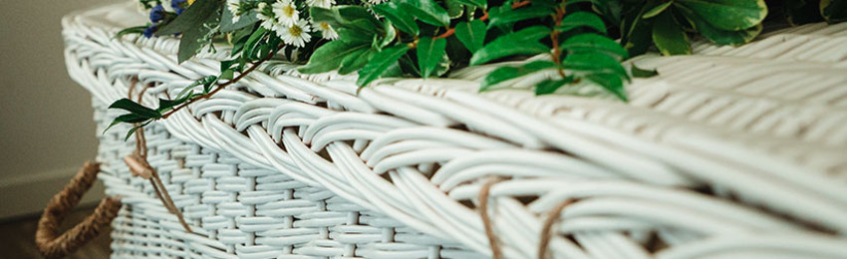
Caskets
Willow
Seagrass
Bamboo
Cardboard
Pine
Notes:
Katie:
Caskets could be made of various biodegradable materials, such as [see slide] The one I just saw recently that didn’t make it onto this list is Recycled PAPER.

Slide 18
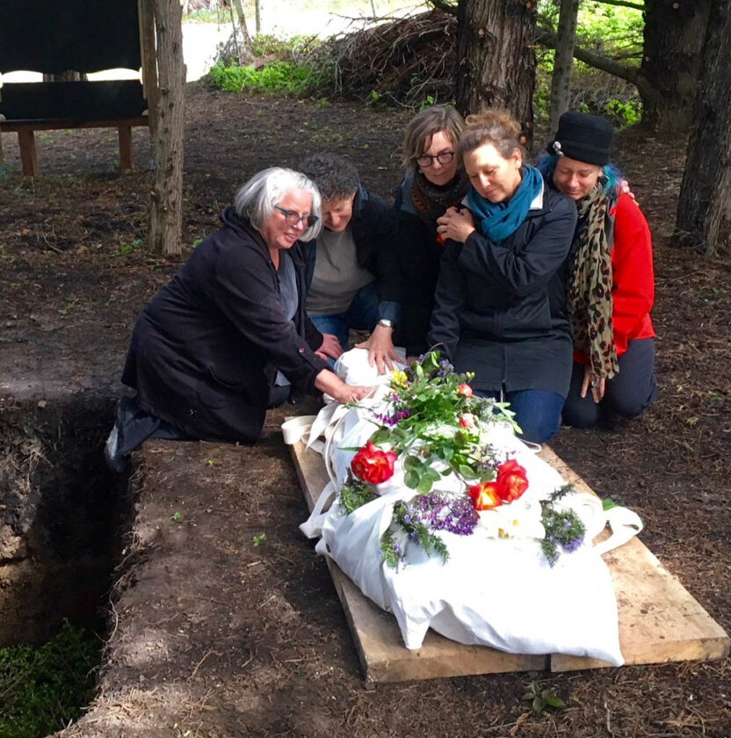
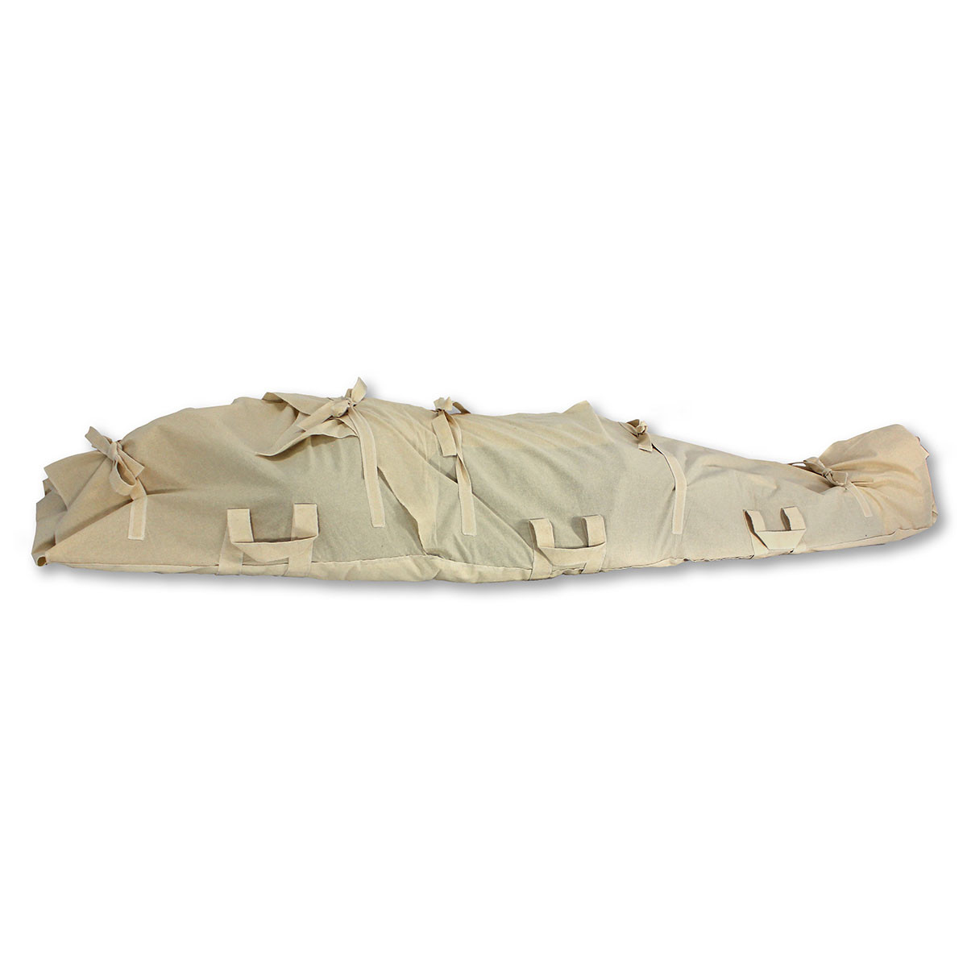
Notes:
Katie:
Here are a couple of examples of shrouds.

Slide 19
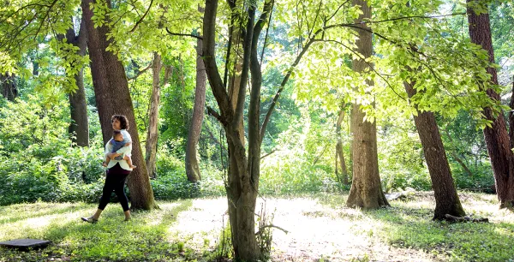
Notes:
Katie:
This might be either a natural burial ground or a conservation burial ground.
Terry:
This is the kind of place where I would prefer to be buried – a forest with sunshine, but I’d really prefer an evergreen forest.

Slide 20
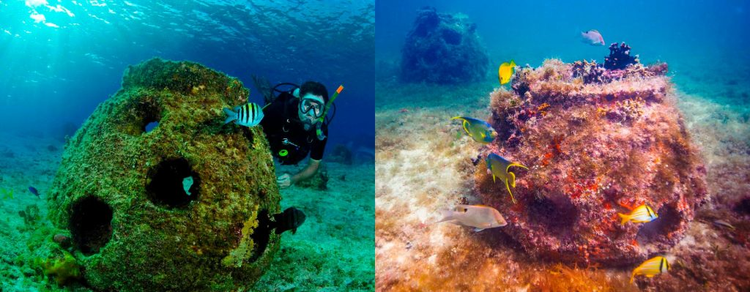
Notes:
Katie:
These are examples of reef balls, or memorial reefs. What they are is ashes mixed with cement and then dropped into the ocean.
If you dive, you can visit them, and, purportedly, fish enjoy them as habitat.
You can even have a destination funeral, for dedication and placement of the reef ball. With more Greenhouse Gas Emissions, of course.

Slide 21
Cremation Options
French fried,
baked,
roasted,
and hash browned.
Notes:
Terry:
We come back to our potatoes. Unfortunately, when we’re talking about alternative burial methods, there aren’t as many options for cremating people as there are for cooking potatoes. Here’s one

Slide 22
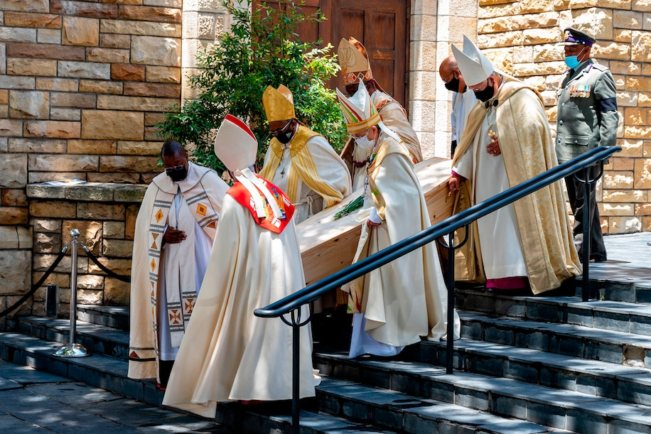
Archbishop Desmond Tutu
Notes:
Terry:
example:
This picture is of the simple wooden casket of the anti-apartheid leader Archbishop Desmond Tutu being carried out of St. George’s Cathedral in Cape Town, South Africa.
The archbishop, who died last year, had requested that his funeral not be ostentatious and that his body not be cremated by flame. Instead, Tutu requested aquamation, or alkaline hydrolysis, a water-based process considered an eco-friendly alternative to traditional cremation.

Slide 23
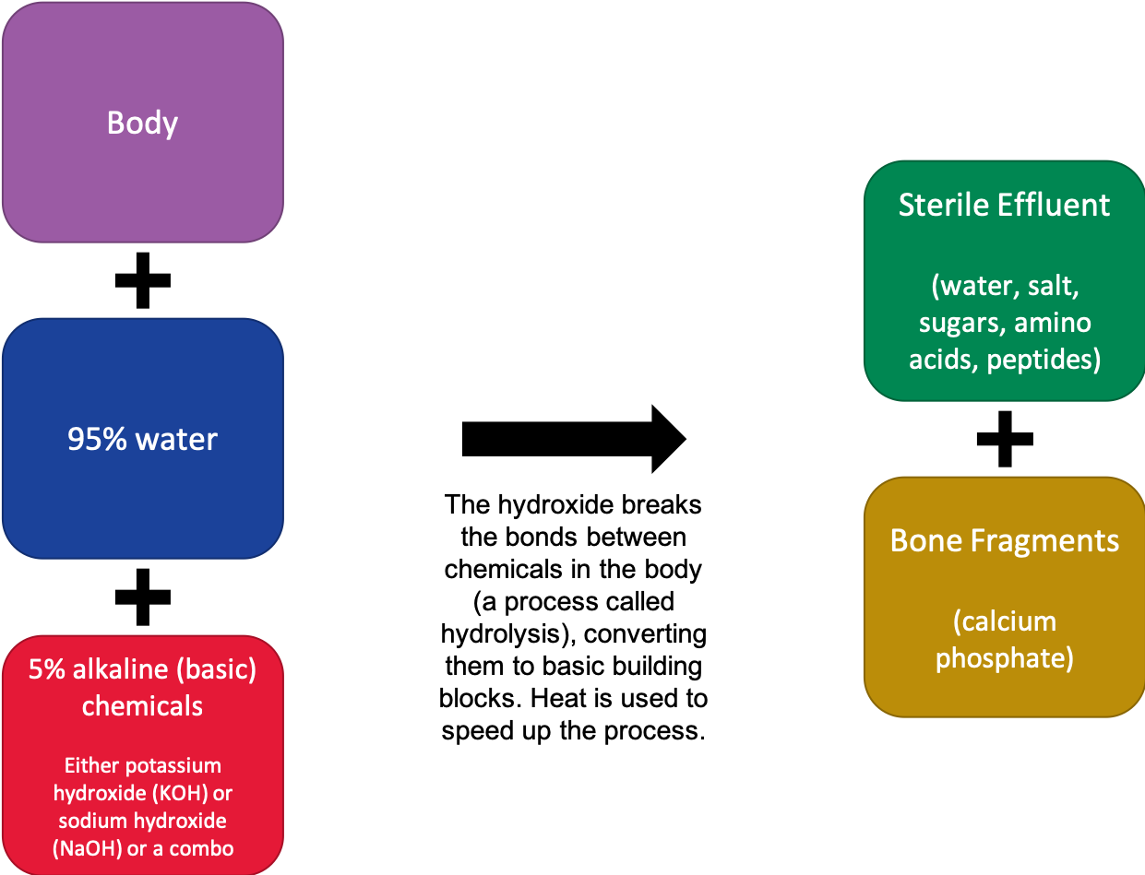
Notes:
Katie:
So, what is water cremation?
Alkaline hydrolysis uses techniques to decompose a body in the same way that it naturally decomposes after burial. This process is sped up dramatically using alkaline chemicals, water, heat, and sometimes pressure, which in turn accelerates the body’s natural decomposition.
Once the process is complete, no tissue or DNA are in the liquid. The only remains in the chamber are bones and the sterile liquid solution.
The bones can then be pulverized and returned to the family. But you might need a bigger urn.
Water cremation has been proposed for legalization in Wisconsin but has been objected to by religious groups. Some think it’s disrespectful to have the liquid go into the municipal waste system. (But – note that in regular embalming, blood and other body fluids go down the drain.

Slide 24
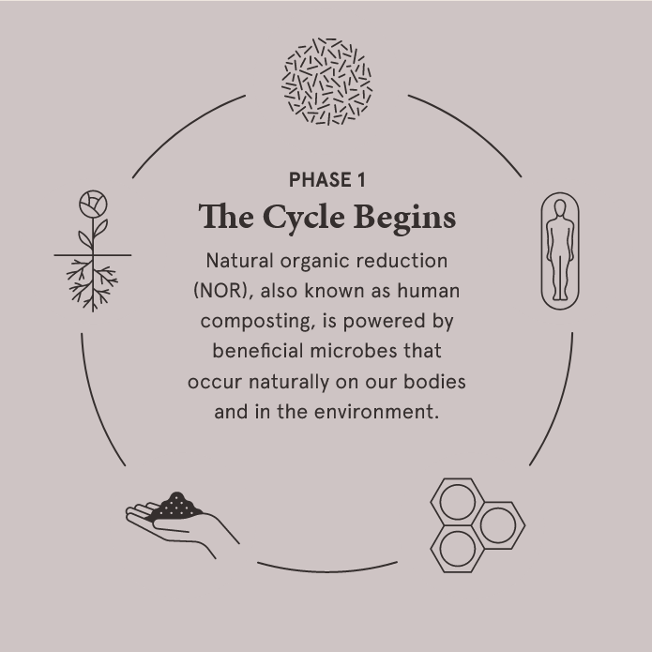
Natural Organic Reduction or human compost-ing
Notes:
Terry:
PHASE 1 The cycle begins (read from slide)
PHASE 2 –The Laying In The staff lay the body in a cylinder surrounded by wood chips, alfalfa, and straw.
PHASE 3 The cradle is placed into a vessel and covered in more plant material. The body and plant material remain in the vessel for 30 days. Microbes break everything down on the molecular level, resulting in the formation of a nutrient‑dense soil.
4 -- Each body has created one cubic yard of soil amendment, which is removed from the vessel and allowed to cure. Once completed, it can be used to enrich conservation land, forests, or gardens (flowers, shrubs, trees, not vegetables).
5 -- and then there is Life After Death The soil created returns the nutrients from our bodies to the natural world. It restores forests, sequesters carbon, and nourishes new life.

Slide 25
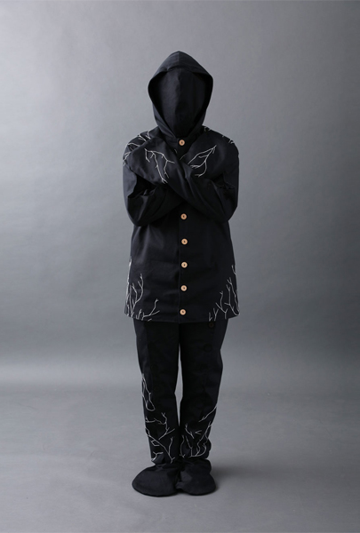
Infinity Burial Suit, a.k.a. Mushroom Suit
>Cleanses the body and soil of toxins that would otherwise seep into the environment
> Delivers nutrients from body to surrounding plant roots efficiently
> Restarts life around the body faster than normal
Made by a California Company, Coeio
Notes:
Terry:
I have a friend who thinks that the mushroom suit is absolutely the best way to go out. Personally, I think it looks scary – for all we do, we must think about the reactions and wishes of survivors, like our grandkids.
What the suit does is it supposedly -- and I say supposedly, because I read an article saying it didn’t work – [talk from slides] (next) (next) (next) (next)

Slide 26

Notes:
OK, I’ll play that video I promised. This one, from AlJazeera, reviews what I’ve told you, and may help you remember the wording to make the conversations easier.

Slide 27
Conclusion – Why choose natural burial?
Conserves natural resources
Reduces carbon emissions
Protects workers’ health
Restores or preserves habitat
Reduces impact of death practices on climate change
Reduces cost
Notes:
Katie:
So – to review – why choose Natural Burial?
(Next) First, it conserves natural resources – all those metals and concrete that goes into making the casket and vault
(Next) Next, it reduces carbon emissions – those greenhouse gases that cause global warming
(Next) Also, it protects workers’ health, by protecting them from exposure to poisonous chemicals
(Next) It restores or preserves habitat, whether by composting or conservation cemeteries keeping lands intact
(Next) An important one, to us – it reduces the impact of death practices on climate change, either by reducing emissions from cremation or the creation of materials to be buried
(Next) And, not to be overlooked, the cost is usually less, because you can forego a lot of the trappings of the practices that have become standard.

Slide 28
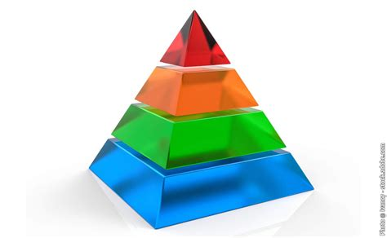
Natural Burial
Human Composting
Water Cremation
Flame Cremtion
Casket & Vault BurIal
Notes:
Terry: So, what’s our conclusion in terms of the greenest burial, the one that uses the least CO2? That would be natural burial, though it uses up more space than human composting or water cremation. Human composting is next, though it’s only available in 5 states, not including Wisconsin. Water cremation comes in third, and it’s legal in Illinois and, I believe in Minnesota. Flame cremation is next, and casket & vault burial clearly takes the prize for using the most CO2.
Katie: The green burial process falls on a spectrum and can include a wide range of options and choices, with the fewer materials and energy-consuming practices being the greenest. But even if one has arrangements already made, know that you still have some of these options. If a greener burial feels like the right choice for you, let it be known and make a plan.
Pitch: Catholic Cemetery Initiative

Slide 29
Let your wishes be known!
Write down
Write down your wishes for a green funeral, including
Where you want to be buried
That you do not want to be embalmed
What, if anything, you want to be buried in
Make
Make arrangements with a funeral home in advance
Choose
Choose a cemetery that offers natural burials
Share
Share your plans with your loved ones, executor, and/or attorney.
See
For additional resources, see the Green Burial Council website, greenburialcouncil.org
Notes:
Katie:
Green Burial is becoming more readily available, and we can’t emphasize enough how important it is to let it be known what your wishes are, especially for something like this that’s not mainstream.
Write down your wishes for a green funeral including where you want to be buried, that you do not want to be embalmed, and what, if anything, you would like to be buried in.
Make arrangements with a funeral home in advance. This will also help you ensure that you have secured a funeral home that will facilitate your wish for a green burial.
Choose a cemetery that offers natural burials and whose practices align with your level of sustainability.
Share your plans with your loved ones, executor, and/or attorney.
For additional resources, see the Green Burial Council website, greenburialcouncil.org

Slide 30
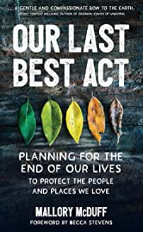
Notes:
Terry:
OK, Now we’re getting into the resources that helped us prepare this program – here’s one book: Our last best act; planning for the end of our lives.

Slide 31
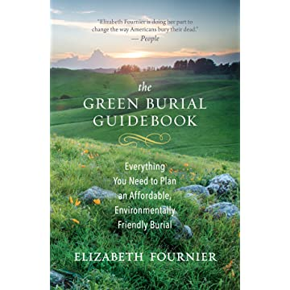
Notes:
Terry:
And another book . . .

Slide 32
Resources, p. 1
Burial and Cremation Laws in Wisconsin (NOLO.com)
The FTC Funeral Rule
The Green Burial Council (website)
  The Science Behind Green and Conventional Burial (article on the site)
  To Lie Down in Green Pastures (article)
  Offering Green Burial Options in Municipal Cemeteries (pdf with FAQ)
Funeral Consumers Alliance (FCA of Greater MKE uses UUCW address)
Yes Magazine’s Death Issue
Our Last Best Act: Planning for the End of our Lives to Protect the People and Places We Love by Mallory McDuff, 2021, Broadleaf Books
We need a greener way to die: Most of us will keep polluting post-mortem.
More States Legalize Dissolving Bodies in Water (from U.S. News and World Report)
What is aquamation, the burial practice Desmond Tutu requested instead of greenhouse gas-emitting cremation? (from Washington Post)
Notes:
Terry:
This resource list, which is 2 pages, will be on the 350.org website.

Slide 33
Resources, p.2
Natural Funeral Practices (Mother Earth News, Oct. 2021)
Death Has a Climate Change Problem (HuffPost)
From Fiction to Reality: Could Forests Replace Cemeteries? (Grist)
Americans are bad at talking about death, and it’s hurting the environment. (The Week, 4-7-22)
The Funeral Industry Is Toxic. Could Green Burials Be the Answer? (Livekindly.co)
We Need a Greener Way to Die Popular Science, May 23, 2019.
The Order of the Good Death.com
The Green Reaper – author of The Green Burial Guidebook
Trevor Noah – The Sustainable Solution
Cremation Association of North America
Talk Death
Trees for a Change: Memorial Trees and Sympathy Gifts
“The green reaper: how to rejoin the infinite with minimal mess” Sierra, fall 2022, p. 56-57
“Is a green burial right for you?” Your Green Life #4, 2023, p.40-41

Slide 34


Questions?
Comments?
Notes:
Terry:
Let’s open it up for discussion, questions or comments. Remember, we’re not experts, so we may have to get back to you with answers.

