Slide 1
Plastic Doesn’t Grow on Trees
The Fight for the Climate
Notes:
The topic of tonight’s discussion …

Slide 2
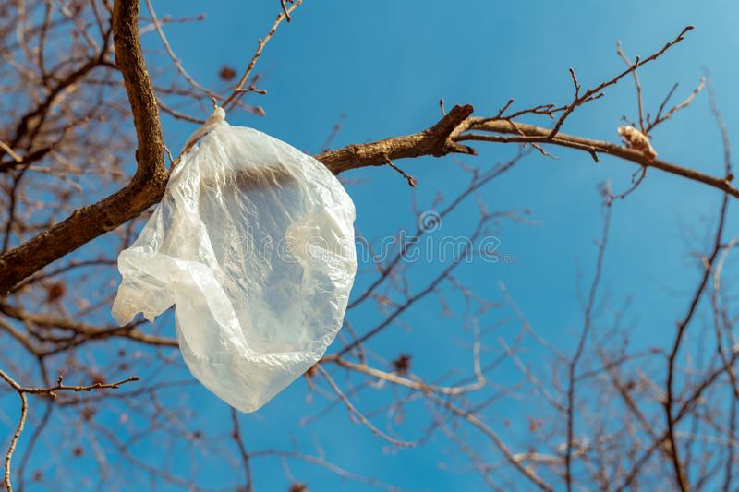
​Why the title?
Kohl’s says they are trying
  Bags 30-50% recycled plastic
  Eliminated plastic bags in select markets
Notes:
G: A few months ago the steering committee was discussing future meeting topics when Terry related a recent experience.
T: I went shopping at Kohl's this summer, and as I was trying to reduce the number of plastic bags needed for my purchase, the very nice clerk said, "Oh, yeah. Gotta save the trees." She actually thought plastic came from trees. While we think you are likely much more informed than that, we hoped we might be able to provide some info that's new to you.
NEXT

Slide 3
Plastic Preview
Luxury goods for everyone!
Why do we use plastic?
Where do we find plastic every day?
Where does plastic go after it’s used?
The CLIMATE COST of Plastic
Where do we go from here?

Slide 4
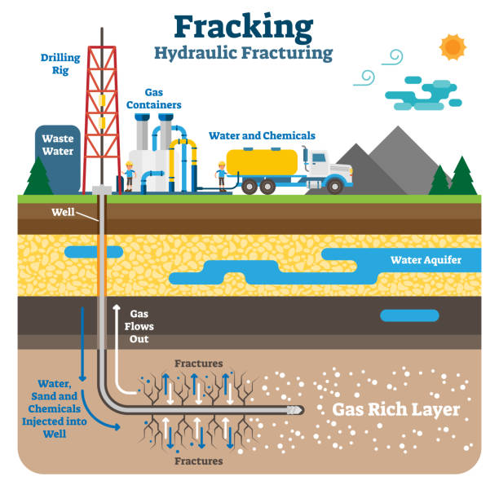
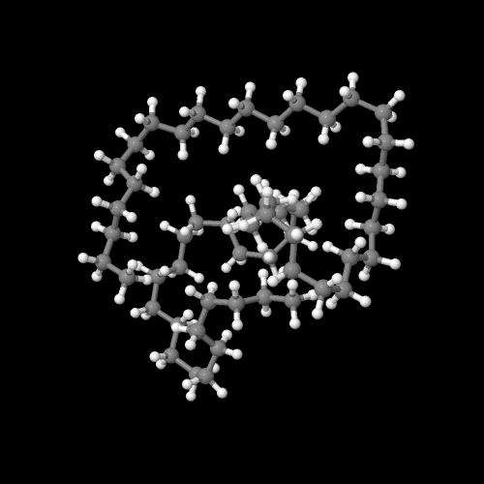
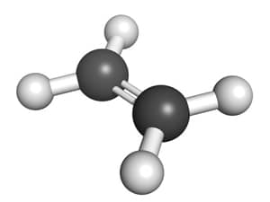


Luxury goods for everyone!
​Plastic - a Carbon Polymer
  Polymer – Greek poly-, “many” + mer, “parts”
Sourcing the Carbon Molecules
  >99% Fossil Fuels - natural gas (90%) & oil

Slide 5
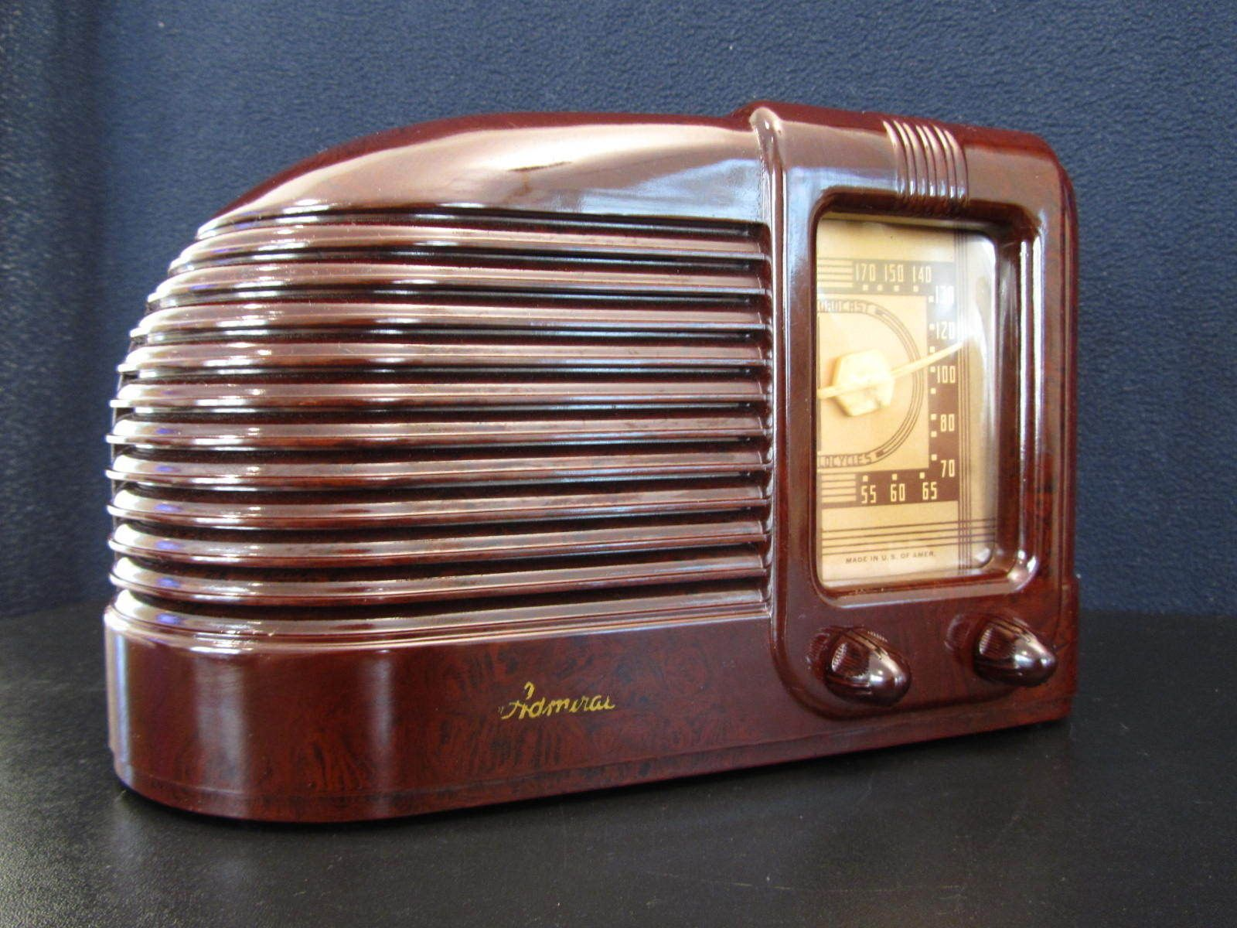

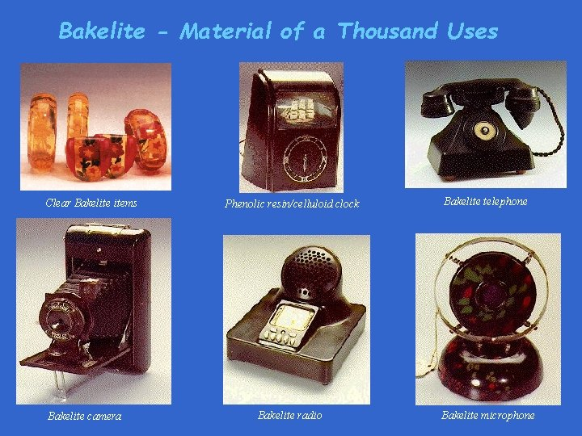
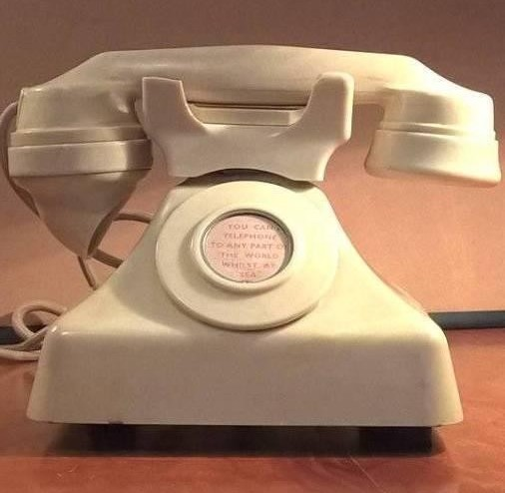


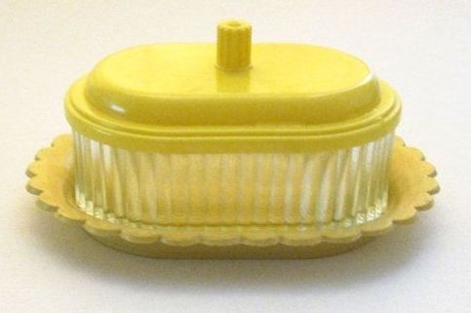
Luxury goods for everyone!
​People have loved carbon polymers for thousands of years
  Mayans, Aztecs and other Mesoamericans were processing rubber by 1600 BC
  Shellac (secreted by the female Lac Bug) was used in India more than 3000 years ago
About 1838 the first synthetic plastic (PVC) was synthesized
In 1907 Leo Baekeland synthesized Bakelite
  Bakelite took off
Notes:
Bakelite was soon being adapted for a broad range of products

Slide 6
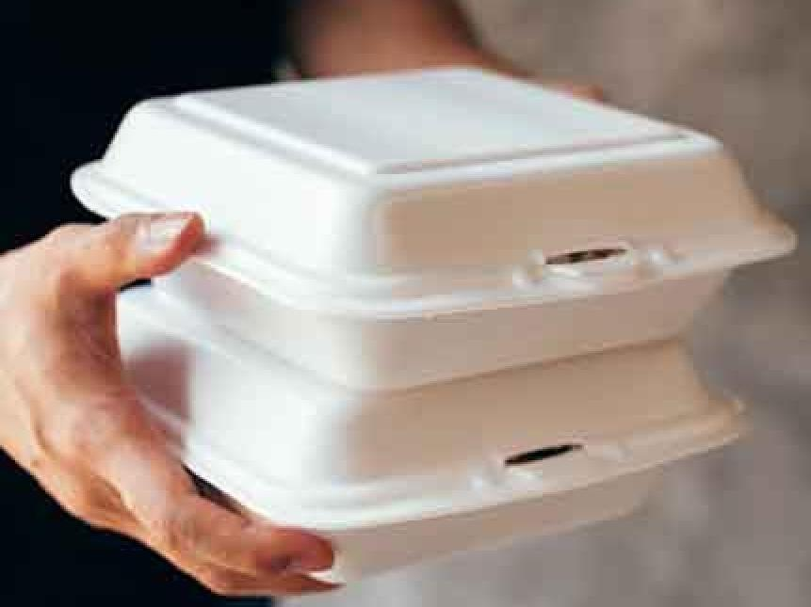
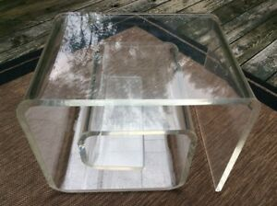
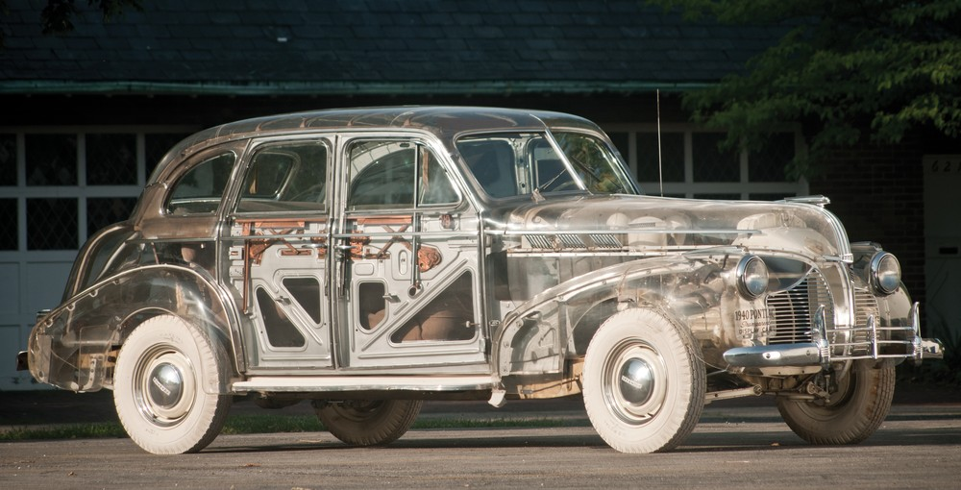
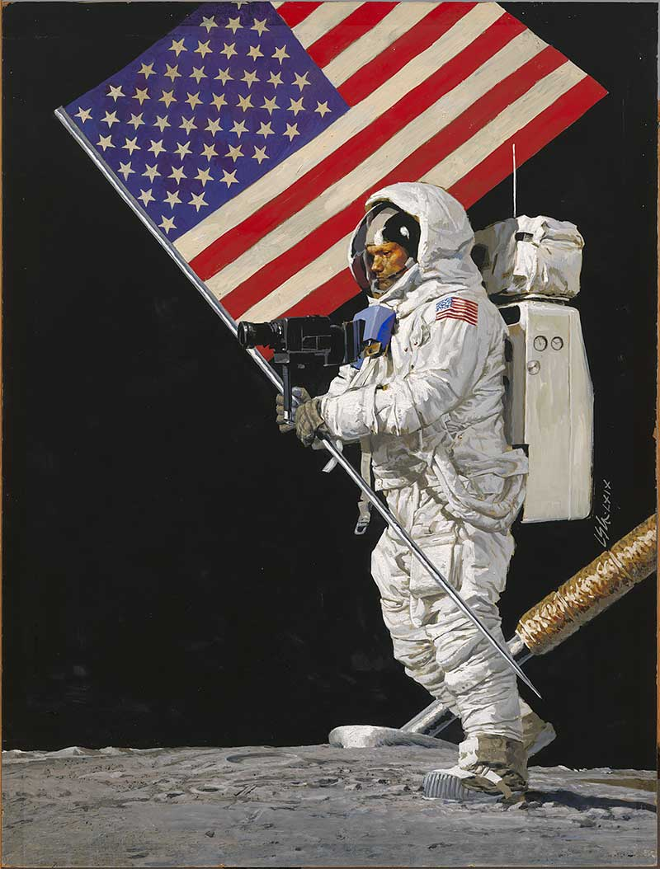
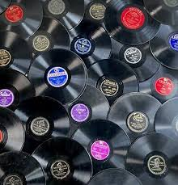
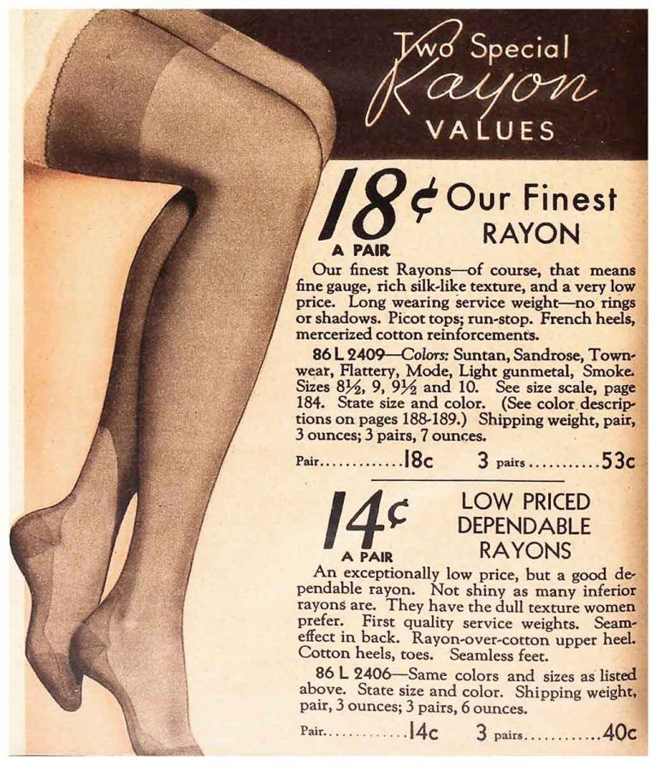
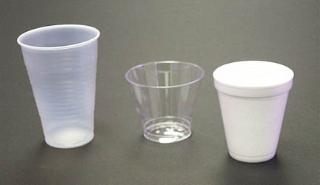
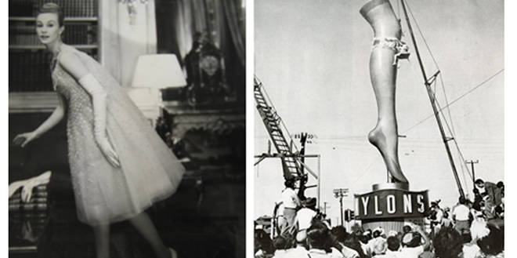
Luxury goods for everyone!
Notes:
Vinyl replaced shellac
1938 - Nylon: A Revolution in Textiles

Slide 7

plastic was embedded in our culture

Slide 8
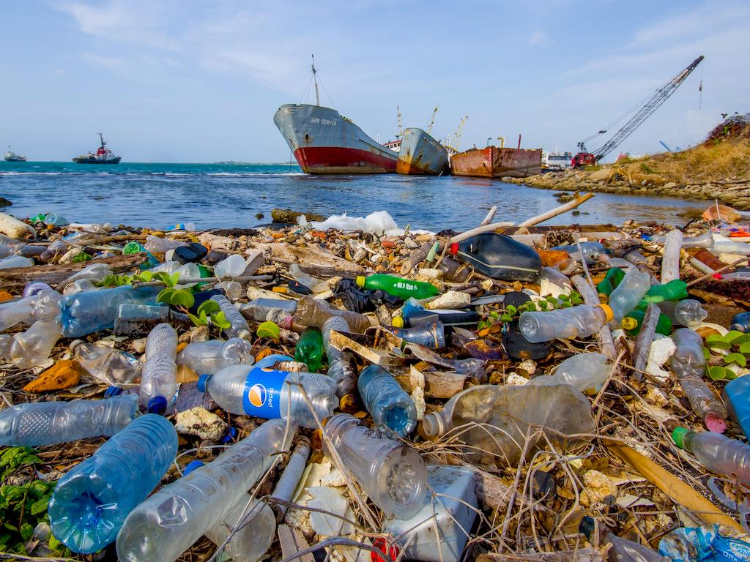
And embedded in our planet
Bali’s famous beaches beaches are being buried by 30 to 60 tons of plastic rubbish each day – not a misprint! – January 2021

Slide 9
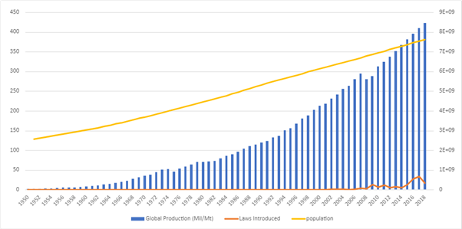
Luxury goods for everyone!
US produces more than 230 lbs. of plastic / person / year
Worldwide - 10 Billion tons since the 1950s
Laws to limit single use plastic
  Small decline in narrow segments
  WI outlawed plastic bag bans – “A ban on bans”

Slide 10
Why do we use plastic?
Audience input
Notes:
What's so good about it? Put single words in the chat about positive characteristics of plastic. I'll read them as they come in.
Doesn't shatter like glass
Lightweight, thus less expensive in terms of fuel and emissions to transport
Convenient
Inexpensive/cheap
NEXT

Slide 11
Where do we find plastic every Day?
Single Use
Clothing
Home – Kitchen, Bathroom
Transportation
Notes:
We're going to put categories on the screen. When we do, please give examples of each category in the chat and I'll call them out.
NEXT
NEXT
NEXT
NEXT slide

Slide 12
Where does plastic go after it’s used?
America alone generates 34.5m tons of plastic each year!
Recycling
Notes:
That's enough to fill American Family Field , 1000 times, maybe more.
Let's talk about recycling first.
Most plastic can only be recycled once or twice
Industry actually started the recycling of plastic, as we'll see in the video.
NEXT

Slide 13

Industry’s role

Slide 14
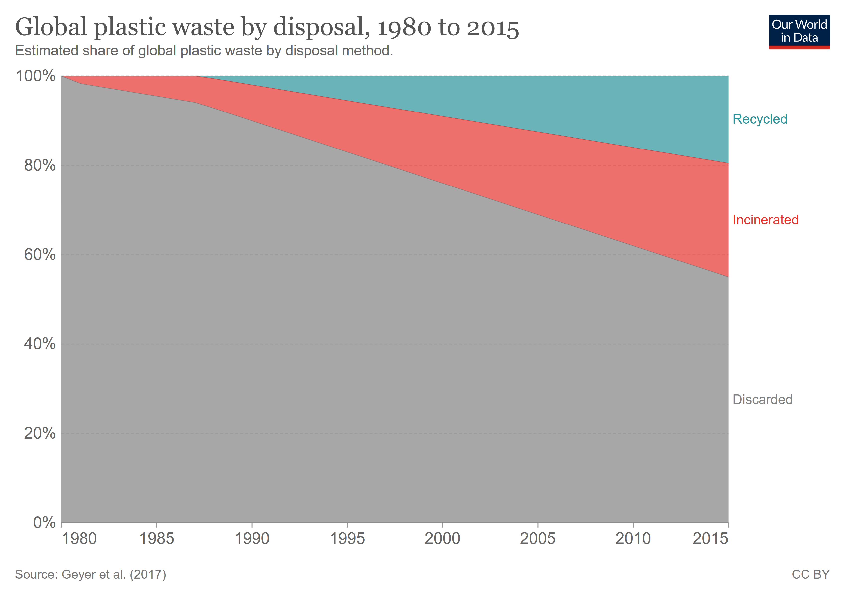
  Landfill
    Permanence
    Pollution
  Environment
    Along roads, streams, lakes, “blowing in the wind”
    Ocean gyres – Five (20% fishing waste)
  Consumed
    From our food, water, air
    Credit card / week
Recycling
  What’s actually recycled
  Exported to other countries
Burning
  Pollution
  GHG
Notes:
Plastic Waste Exports Have Been Shipped Off and Counted as Recycled for Decades
In 2018, after China and other Asian countries had stopped accepting imports of U.S. plastic, much of it went to Malaysia for processing. Often, such processing meant illegally burning plastic, with toxic fumes inhaled by the neighbors of the illegal dumps.
We also see from this graph that about 55% of plastics go straight to landfills.
What it doesn't show us is that about 30% of plastics that have been manufactured are still in use.
NEXT

Slide 15
The Climate COST of Plastic
  Plastic has broad impact – Health, Pollution, Mortality, Destruction
  and the CLIMATE!
    Production of plastic feedstock
    Manufacturing plastic products
    Plastic disposal

Slide 16
The Climate COST of Plastic
  Plastic feedstock – extracting/transporting the raw material
    Natural gas is the source of 90% of plastic’s raw material
    Natural gas is 70 – 90% METHANE!
    As a GHG Methane is 30x to 80x more potent than CO₂
      Good News – methane’s half life is about 10 years. Whew, we dodged a bullet!
      Oh no! It breaks down into CO₂ and H₂O – both GHGs
      Natural gas to fuel 10,000 homes ($2 billion) leaks every year
    In addition there is the energy to extract and transport

Slide 17
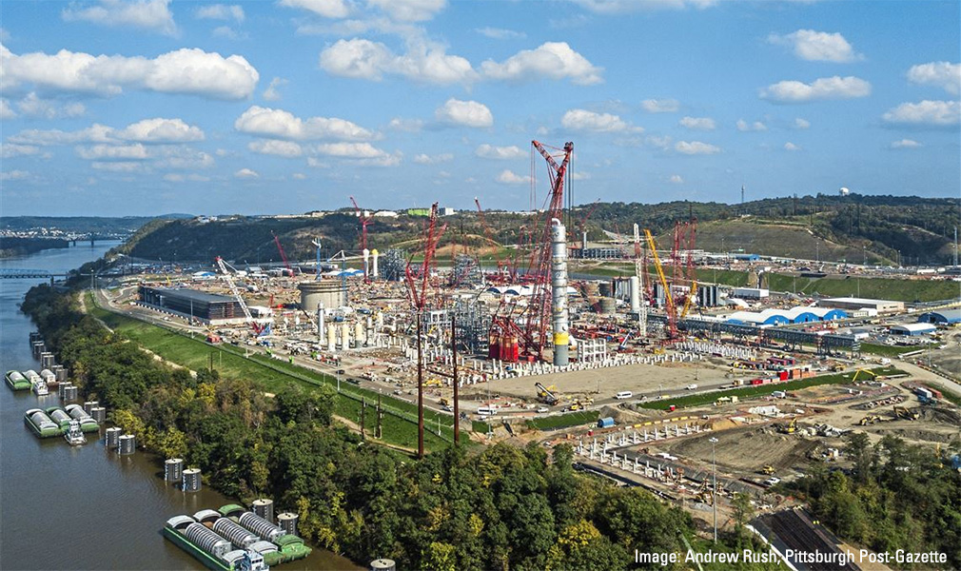
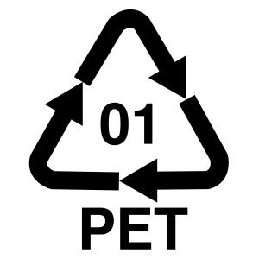
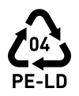
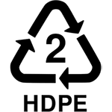
The Climate COST of Plastic
  Producing the building blocks of plastic
    “Cracking” natural gas
    Emissions from producing ethylene are about 0.8% of global CO₂
  Polyethylene makes up about 34% of the plastics market
    >2.2% - Total global CO₂ emissions from plastic feedstock production
    Most common consumer plastic
      Hard plastic food containers including bottles
      Plastic shopping bags
      Package film and “Saran Wrap” – formerly PVC
    Very versatile – medical tubing, buckets, bins, bullet proof vests
Notes:
T – add to chat: There are 35 cracking plants in the US

Slide 18
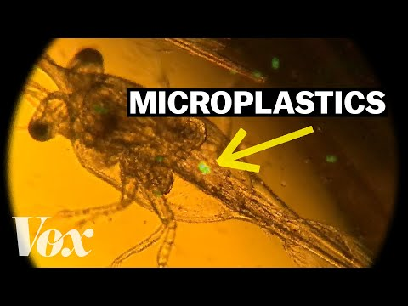
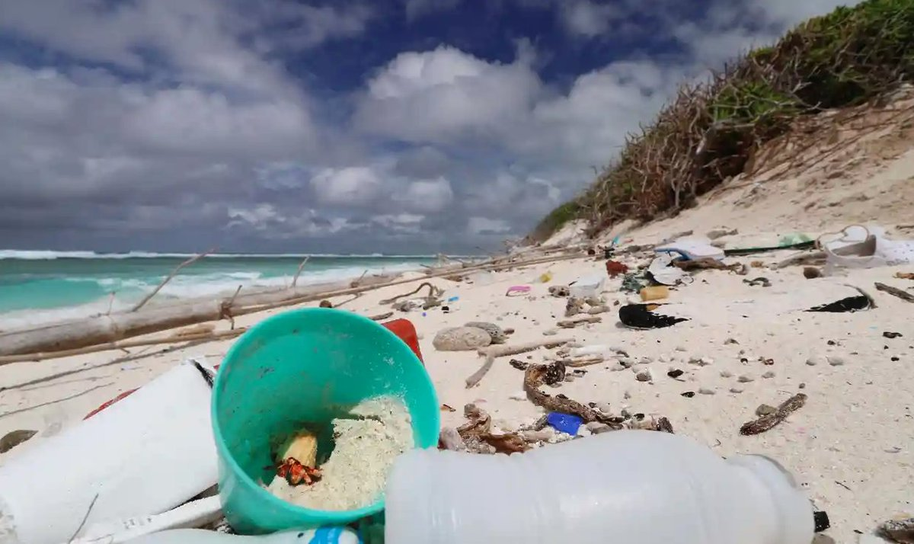
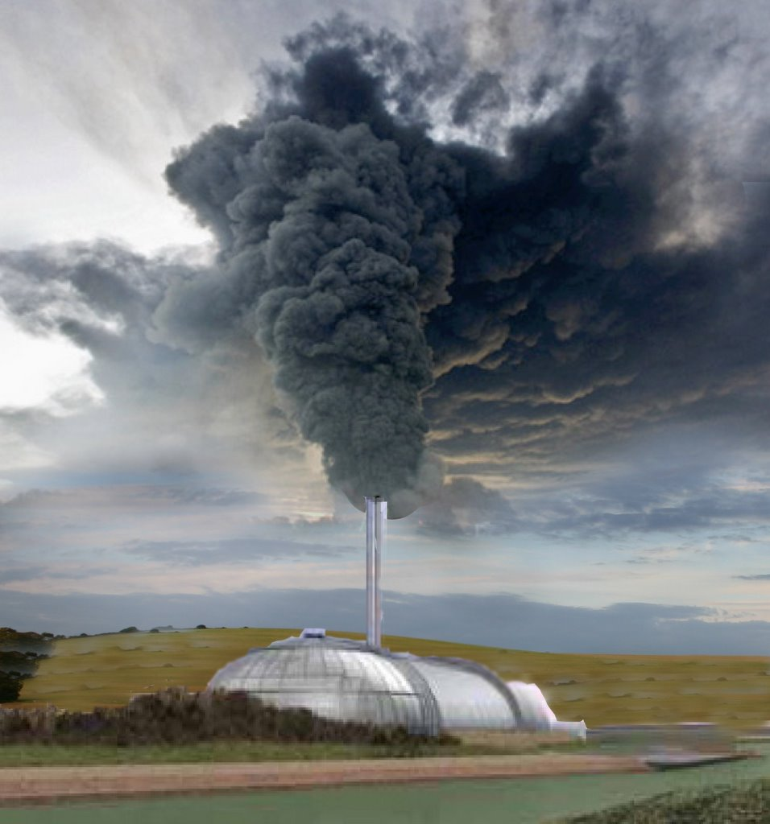
The Climate COST of Plastic
Disposal of plastic
  ~92% of plastic was NOT recycled in 2018 – some polyethylene is recycled
  Air
    Incineration is not viable
      Recycling saves more energy
      GHG & Toxic pollutants
  Ocean
    Plastic interferes with lifecycles of phytoplankton and zooplankton
  Land
    Plastic polluted beaches are up to 2.5° C warmer - Journal of Hazardous Materials, May 2021
Notes:
Terry’s earlier slide – lots of duplication here

Slide 19
Where do we go from here
Plastics are a “blind spot” in the energy and climate debate
  The fossil fuel industry is counting on plastic to drive future growth
Today, about 4-8% of annual global fossil fuel consumption is associated with plastics
If this reliance on plastics persists, plastics will account for 20% of fossil fuel consumption by 2050
Notes:
Read from PLASTIC AND THE CLIMATE slide after Greg says "plastics are a blind spot"

Slide 20
Where do we go from here
Call on Companies to
  Urgently move to re-use systems and package free products
  Commit to collaborating with others to standardize reusable packaging
  Phase out all single-use plastic (packaging and products)
  Be transparent
  Advocate for political action to drive industry-wide transformation
  More explanation of these points is available in "The Climate Emergency Unpacked," listed in the References at the end of this presentation
Notes:
Packaging is the largest contributor to plastic waste (accounting for around 42 percent of the total).
Packaging is the dominant form of waste because it: is the sector which uses the most plastic, and it has a very low product lifetime, so typically becomes waste within 6 months.
Most of our current approaches to tackling the problem of global plastic pollution focus on very small-impact solutions (e.g. plastic straw bans -- It’s estimated that if all straws around the world’s coastlines were lost to the ocean, this would account for approximately 0.03 percent of ocean plastics).
These approaches, whilst well-intentioned, will be quickly absorbed by the growth of global plastics production. Even so, they are important as stepping stones, as ways to get people involved and begin to understand the issues with plastics, just as recycling was when it was introduced.
We must focus on the high-impact solutions. Understanding the global picture of plastic pollution helps us to do this.
Unfortunately we don’t have Producer-Responsibility programs in place for single-use packaging and food ware, despite the fact that those products are also hazardous and hard to dispose of. That’s why we need to create them. British Columbia has done this, and a handful of U.S. states — from Washington to Maine — are considering similar programs. If implemented, these programs would create jobs, generate revenue streams for local municipalities to further reduce waste and, in the long run, improve human health and help fight climate change.

Slide 21
Where do we go from here
Call on Local and National Governments to
  Work with the communities that are most impacted by plastic production, pollution, use, and disposal
  Support the development of an ambitious Global Plastics Treaty
  Move toward a zero-waste economy
  Encourage a phase-out of single-use plastic
  Encourage adoption of re-use and packaging-free systems
  More explanation of these points is available in "The Climate Emergency Unpacked," listed in the References at the end of this presentation
Notes:
Governments can do a variety of things to reduce the impacts of plastics.
Often times the communities that are impacted by plastic production are BIPOC and/or poor communities, so recognizing and ameliorating environmental injustices is important.
A Global Plastics Treaty could go a long ways to solving some of the disparities in the way various counteries produce and dispose of plastics.
A zero-waste economy would be the ideal.
Encourage a phase-out of single-use plastic. That's the work of the Plastic-Free Milwaukee group here in Milwaukee. As I mentioned before, straws are only a teensy-tiny part of the plastics burden, but talking about them and working to eliminate them is an entrée to raising consciousness about all the issues with plastics.
And, we need to encourage the adoption of re-use and packaging-free systems. It's my understanding that The Glass Pantry store in Walker's Point aims to get us started on this path.
NEXT

Slide 22
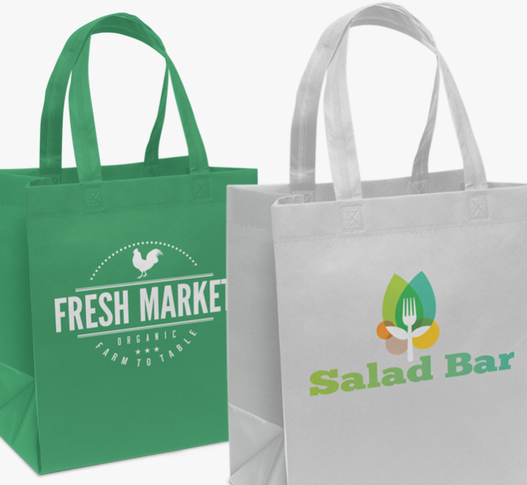
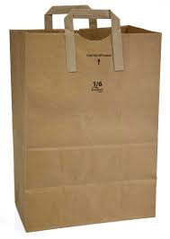
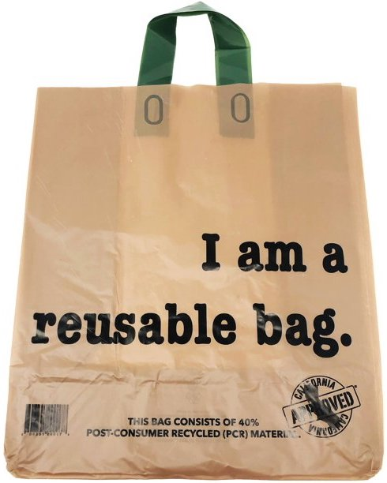
Where do we go from here
Individual Actions
Environmental impact of “shopping bag” production studies
  Plastic baseline – used twice, goods and trash
  Paper – 3 to 10 uses
  Reusables
    Cotton – 131 uses
    Nonwoven polypropylene (plastic) – 11 uses
Reported obstacle – people don’t bring the bags!
Takeaway – REUSE every bag that comes into your possession
Become that “weird” person at the market
  Reduce “convenience” packaging at stores – Bring your own bags
Notes:
Packaging is the largest contributor to plastic waste (accounting for around 42 percent of the total).
Packaging is the dominant form of waste because it: is the sector which uses the most plastic, and it has a very low product lifetime, so typically becomes waste within 6 months.
Most of our current approaches to tackling the problem of global plastic pollution focus on very small-impact solutions (e.g. plastic straw bans -- It’s estimated that if all straws around the world’s coastlines were lost to the ocean, this would account for approximately 0.03 percent of ocean plastics).
These approaches, whilst well-intentioned, will be quickly absorbed by the growth of global plastics production.
We must focus on the high-impact solutions. Understanding the global picture of plastic pollution helps us to do this.
Unfortunately we don’t have Producer-Responsibility programs in place for single-use packaging and food ware, despite the fact that those products are also hazardous and hard to dispose of. That’s why we need to create them. British Columbia has done this, and a handful of U.S. states — from Washington to Maine — are considering similar programs. If implemented, these programs would create jobs, generate revenue streams for local municipalities to further reduce waste and, in the long run, improve human health and help fight climate change.
Make own yogurt & hummus
Bag bans illegal in Wisconsin
EPR (extended producer responsibility

Slide 23
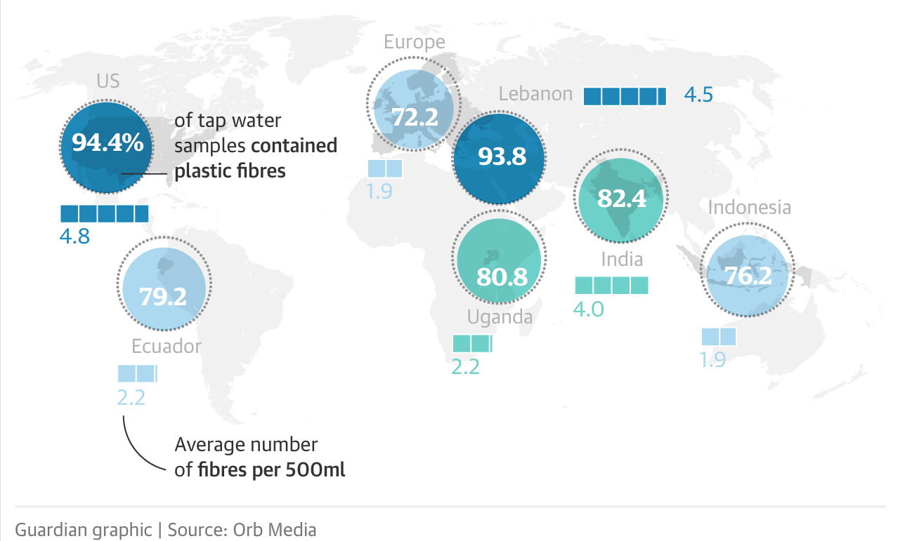
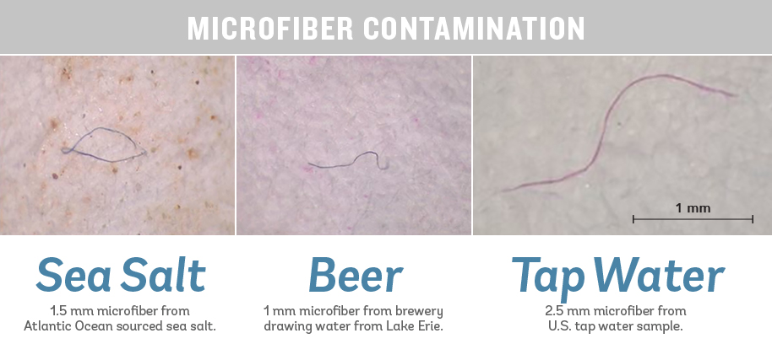
Where do we go from here
Individual Actions
Clothing
  >69% of clothing textiles are fossil fuel synthetics – Tecnon Orbichem (2021)
  “It’s in the waistband of your jeans, your shoes, in practically everything you wear, because plastic is this miracle material,” - George Harding-Rolls
  Washing sheds plastic microfibers into the environment
  We are literally eating, drinking and breathing our clothing, bags and bottles

Slide 24
Where do we go from here
Individual actions – As Greta Thunberg has said, the biggest thing we can do as individuals is not act like individuals.
Individual Action – what do we do?
Notes:
Evaluate every purchase
Carry containers in your car to use for "doggy bags"
Make own yogurt & hummus intead of buying those items in plastic containers
Cotton shower curtains
Bag bans illegal in Wisconsin
Most of our current approaches to tackling the problem of global plastic pollution focus on very small-impact solutions (e.g. plastic straw bans -- It’s estimated that if all straws around the world’s coastlines were lost to the ocean, this would account for approximately 0.03 percent of ocean plastics).
These approaches, whilst well-intentioned, will be quickly absorbed by the growth of global plastics production.
We must focus on the high-impact solutions. Understanding the global picture of plastic pollution helps us to do this.
NEXT

Slide 25
references
The Story of Plastic (Full Documentary) YouTube 1 ½ hours
The New Coal: Plastics and Climate Change
How to Eat Less Plastic – Consumer Reports
Why Plastics Are Also a Climate Issue
Solving Plastic Pollution Will Help Us Stop Climate Change
The Climate Impact of Single Use Plastics
Are Tote Bags Really Good for the Environment?
How Plastics Contribute to Climate Change
Paper, Plastic or Reusable?
Are clothes made from recycled materials really more sustainable?
Notes:
This entire slide show, including the references, will be posted on the 350 Milwaukee website.

Slide 26
references
Plastic Free MKE
Fast fashion’s dependence on fossil fuels - Changing Markets Foundation
Plastic fibres found in tap water around the world, study reveals
The Climate Emergency Unpacked: How Consumer Goods Companies are Fueling Big Oil's Plastic Expansion
Plastic & Climate: The Hidden Costs of a Plastic Planet
Report: Plastic is on track to become a bigger climate problem than coal
EDCs – an invisible cause of obesity
Where does your plastic go? Global investigation reveals America's dirty secret
Beyond Plastic | U.S. PIRG

